Slide 1





Object Oriented Programming (OOP)

Slide 2

Hello!
I am Eslam Ahmed
I am a software engineer.
You can find me at jeksogsa@gmail.com

Slide 3

Hello!
I am Eman Ehab
I am a ML research engineer.
You can find me at emanehab.ieee@gmail.com

Slide 4



Why OOP ?!
Let’s see Why ^_^

Slide 5
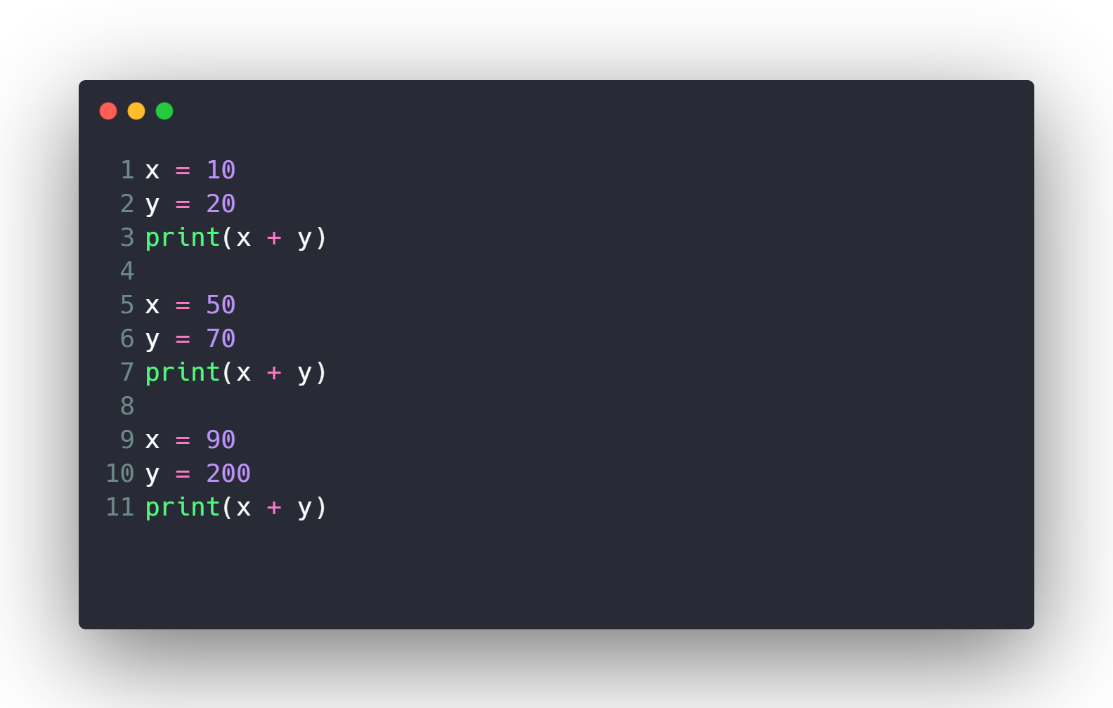
Calculate Sum 10000 times ?!

Slide 6

Calculate Sum 10000 times ?!
What if I want to modify code to multiply ?

Slide 7
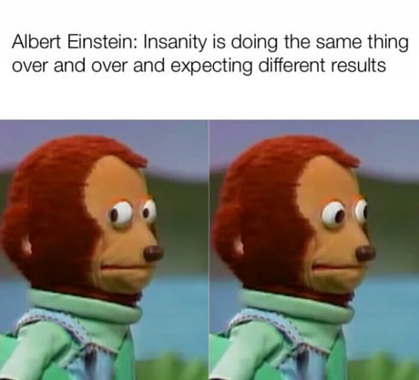
Calculate Sum 10000 times ?!
What if I want to modify code to multiply ?

Slide 8
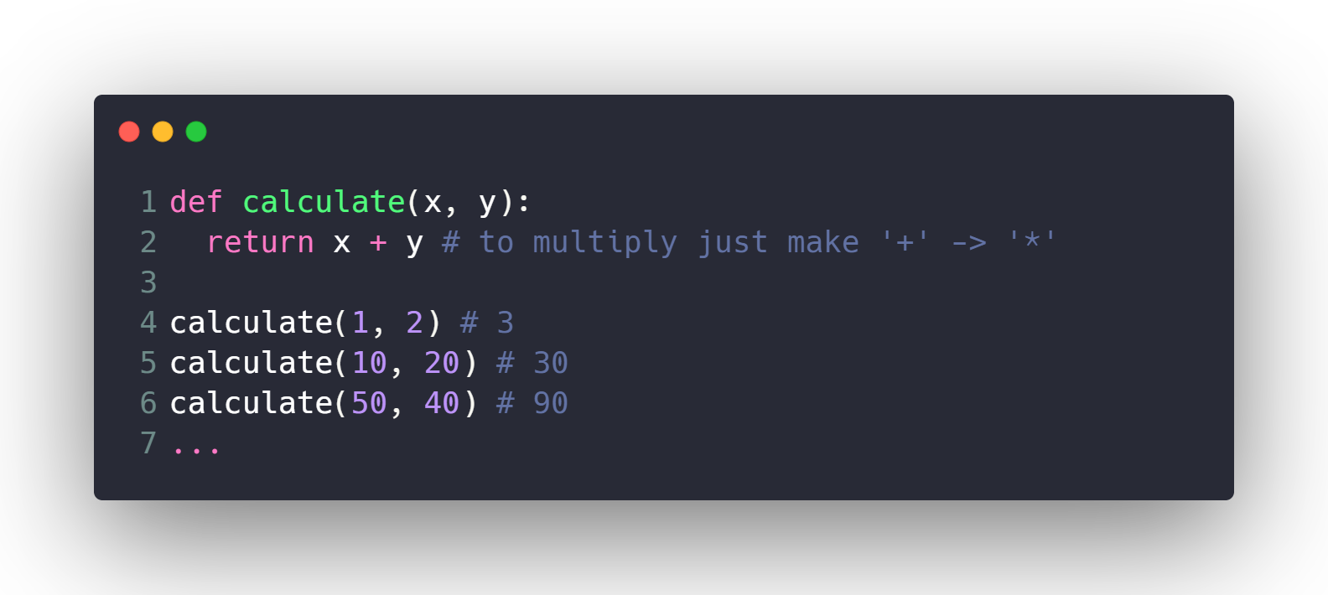
Calculate Sum 10000 times ?!
What if I want to modify code to multiply ?
Much Better ^_^

Slide 9
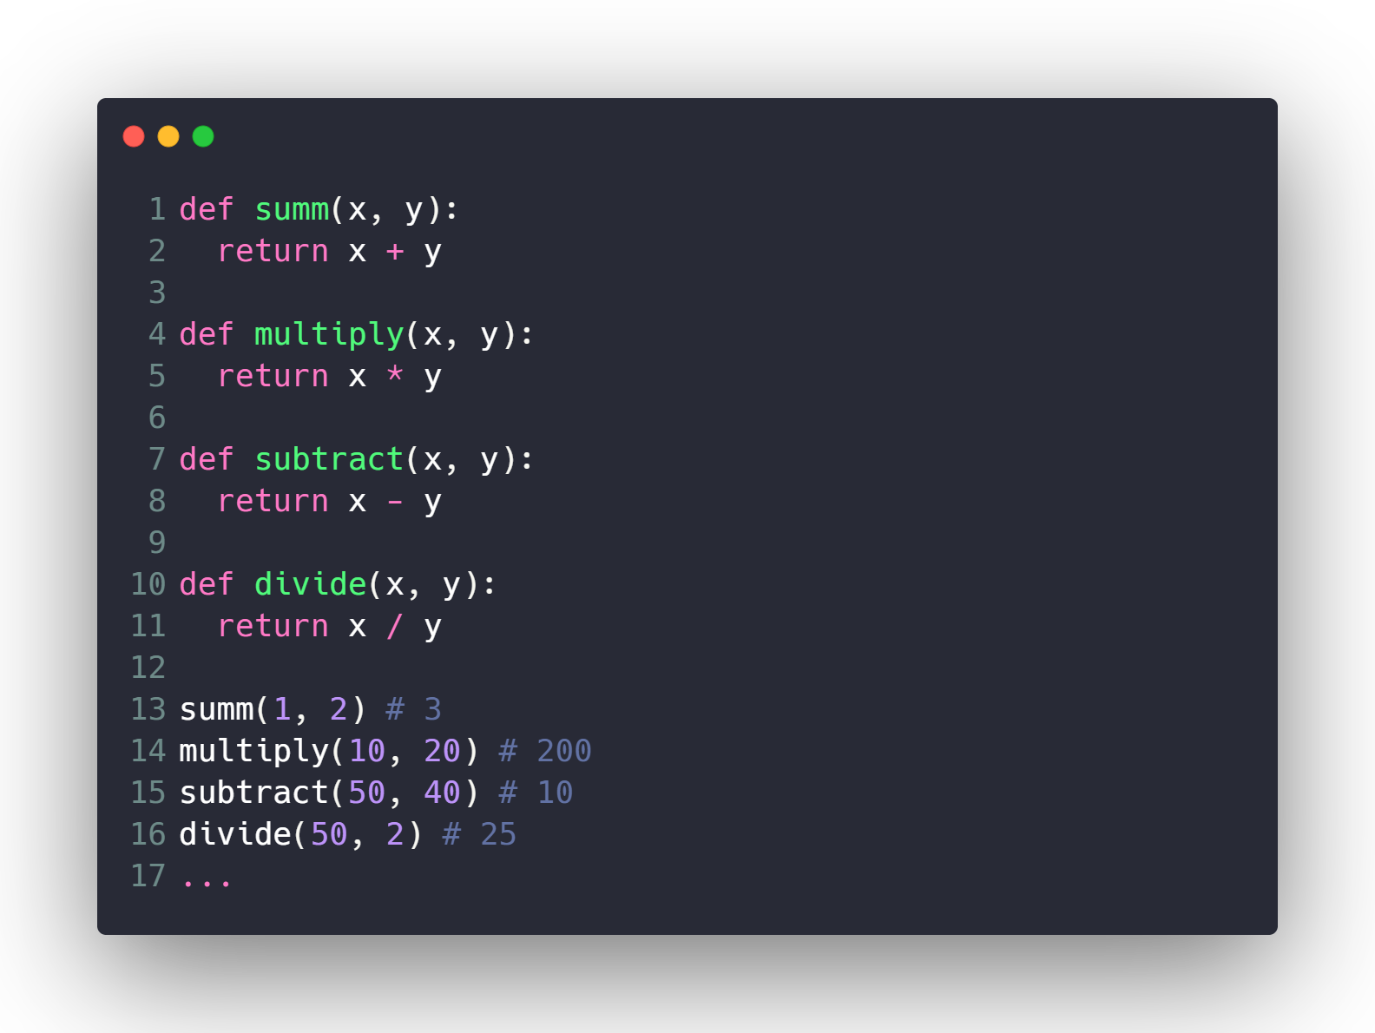
Make Full Calculator ?

Slide 10
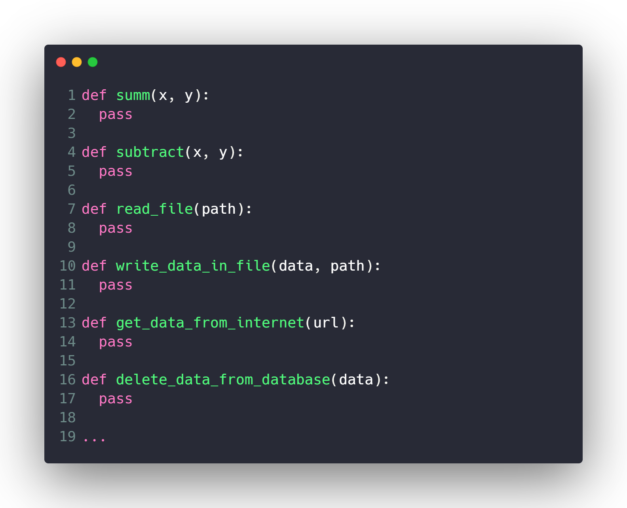
Make Lots of Features ?

Slide 11
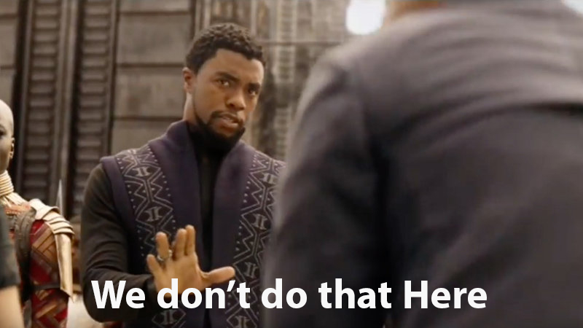
Make Lots of Features ?

Slide 12








What is OOP ?!
Everything is an
Object

Slide 13
Dog
Properties
Size
Color
Breed
Age
…
Methods
Run()
Park()
Eat()
Sleep()
…

Slide 14
Car
Properties
Model
Color
Plate Number
Speed
…
Methods
Move_Forward()
Move_Backward()
Break()
Throttle()
…

Slide 15
Person
Properties
Name
Age
Address
Gender
…
Methods
Eat()
Sleep()
Walk()
Pray()
…

Slide 16
Camera
Properties
Lens_width
Has_Flash
Depth
…
Methods
Take_Photo()
Take_Video()
Toggle_Flash()
Zoom()
…

Slide 17
Machine Learning Model
Properties
Name
Learning_rate
Num_of_iterations
Weights
…
Methods
fit()
predict()
…

Slide 18
Classes & Objects

Slide 19
Person
Properties
Name
Age
Address
Gender
…
Methods
Eat()
Sleep()
Walk()
Pray()
…

Slide 20
Class: Person
Object 1
Name: Eslam
Age: 26
Gender: Male
Eat Meat
Sleep at 9 pm
Object 2
Name: Ahmed
Age: 15
Gender: Male
Eat Chicken
Sleep at 12 am
Object 3
Name: Sara
Age: 30
Gender: Female
Eat Fish
Sleep at 6 am

Slide 21
Machine Learning Model
Properties
Name
Learning_rate
Num_of_iterations
Weights
…
Methods
fit()
predict()
…

Slide 22
Class: Machine Learning Model
Object 1
Name: Linear Regression
…
Fit()
Predict()
Object 2
Name: SVM
…
Fit()
Predict()

Slide 23
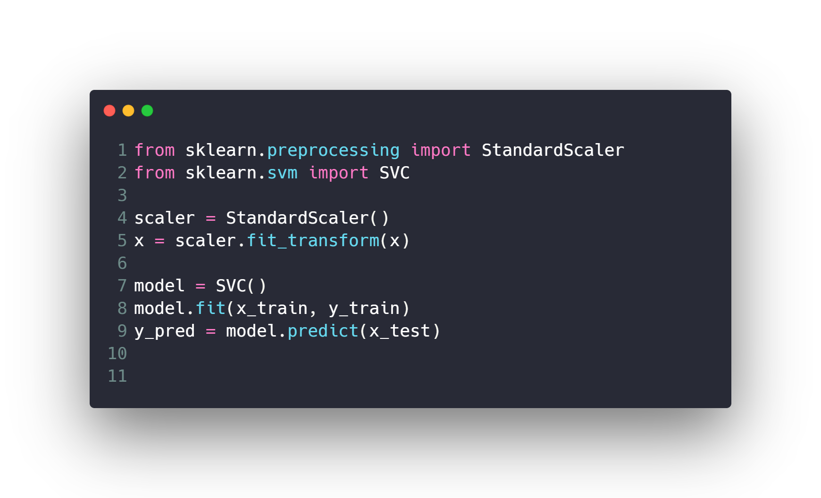
Example of Classes & Objects in Python ?

Slide 24
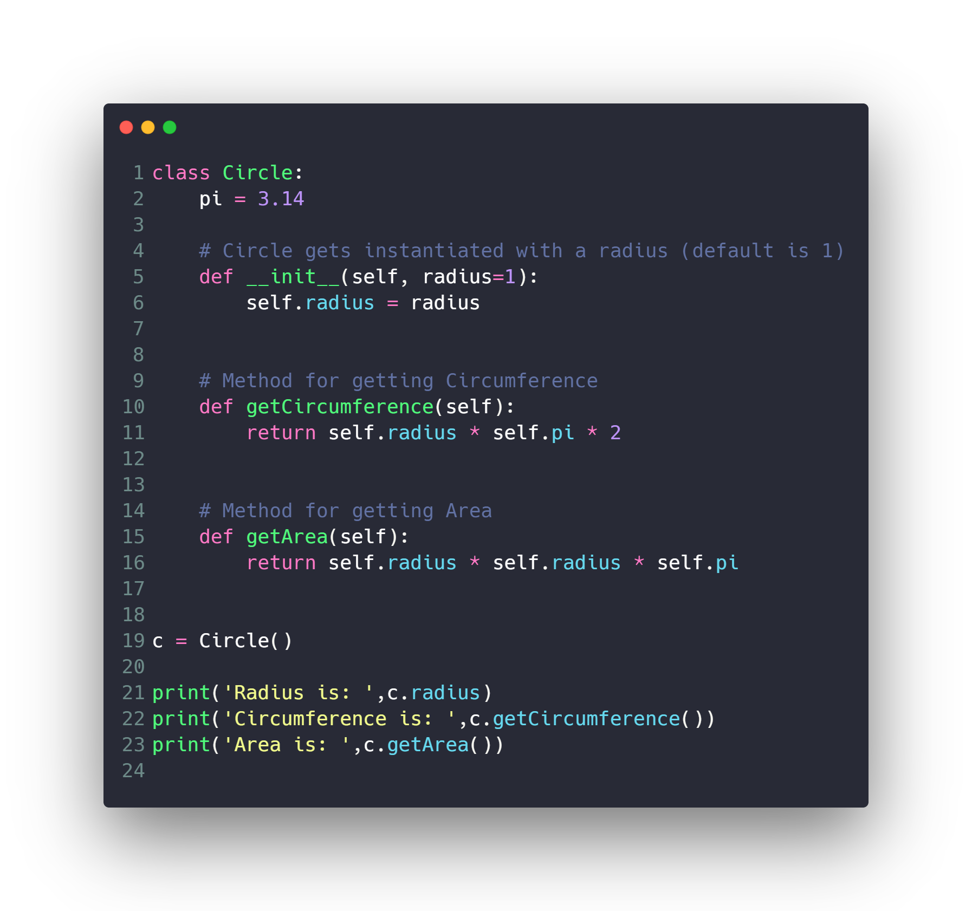
OOP in Python ?
Circle

Slide 25
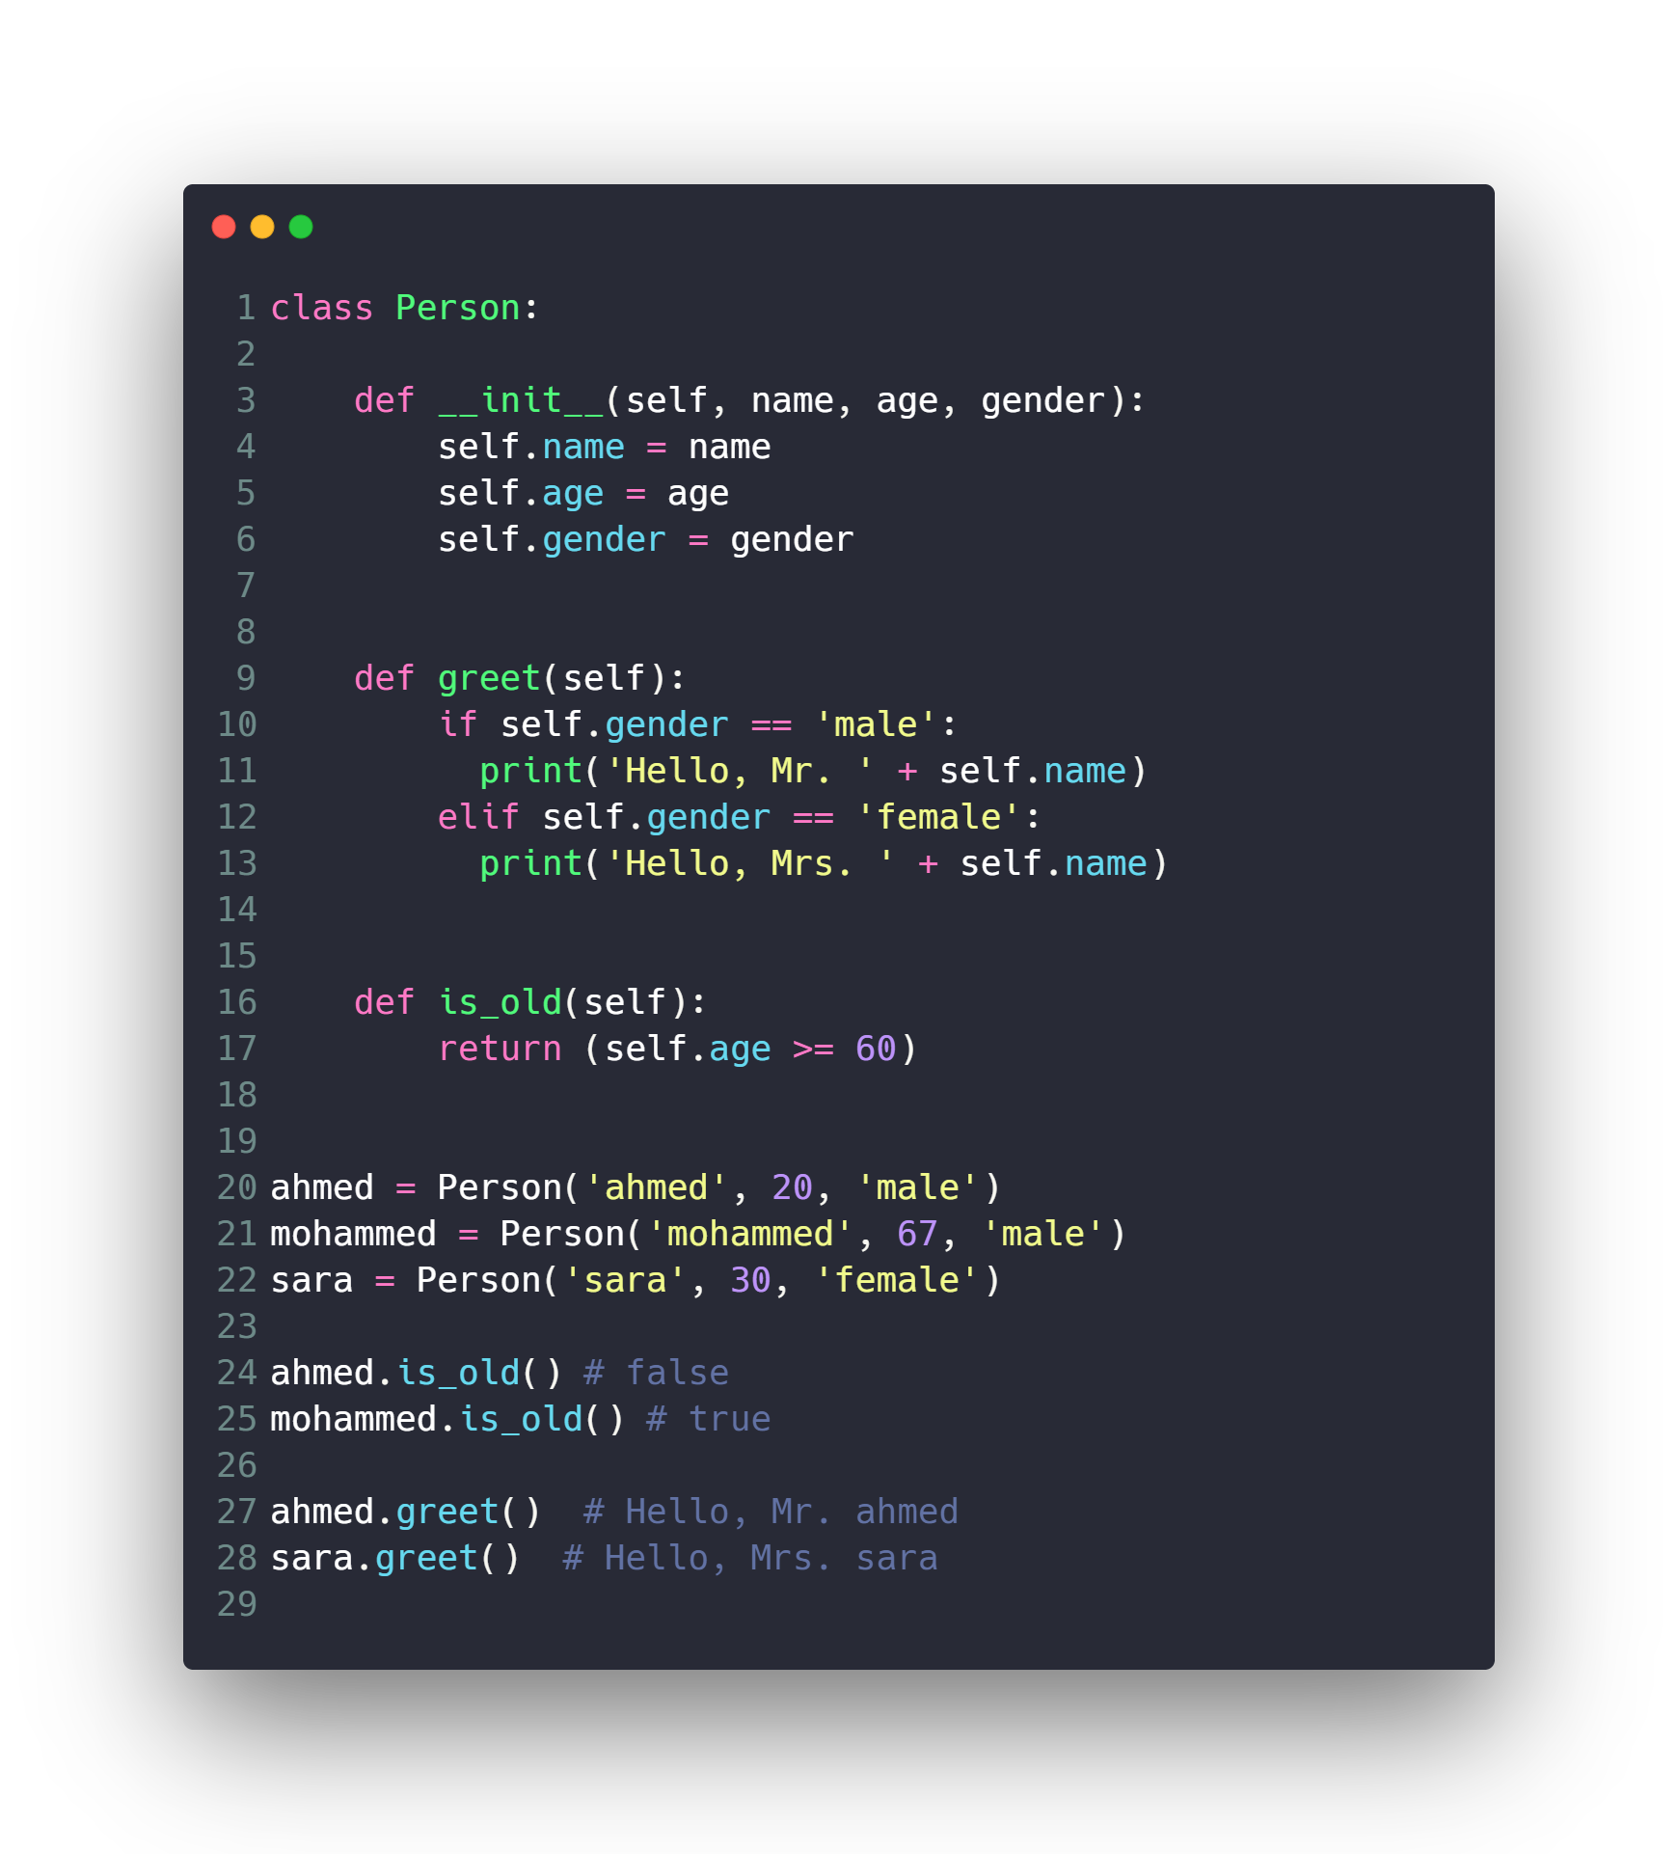
OOP in Python ?
Person

Slide 26
OOP Concepts
Data Hiding (Encapsulation)
Inheritance
Polymorphism
Special Functions and Operators Overloading

Slide 27
Data Hiding (Encapsulation)

Slide 28
Data Hiding (Encapsulation)
An object's attributes may or may not be visible outside the class definition. You need to name attributes with a double underscore prefix, and those attributes then are not be directly visible to outsiders.

Slide 29
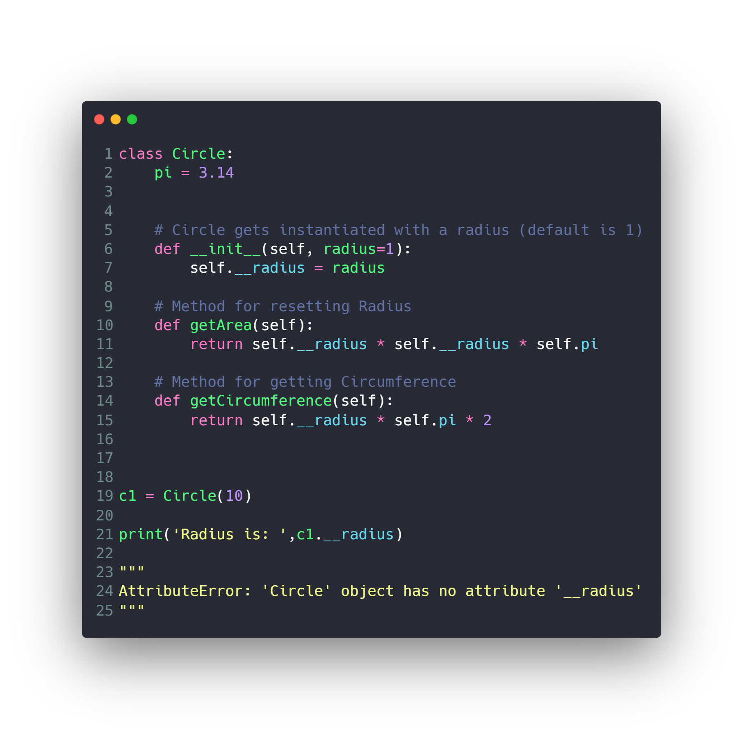
Data Hiding (Encapsulation)

Slide 30
OOP Concepts
Data Hiding (Encapsulation)
Inheritance
Polymorphism
Special Functions and Operators Overloading

Slide 31
Inheritance

Slide 32
Inheritance
It is a way to form new classes using classes that have already been defined. The newly formed classes are called derived classes, the classes that we derive from are called base classes.

Slide 33
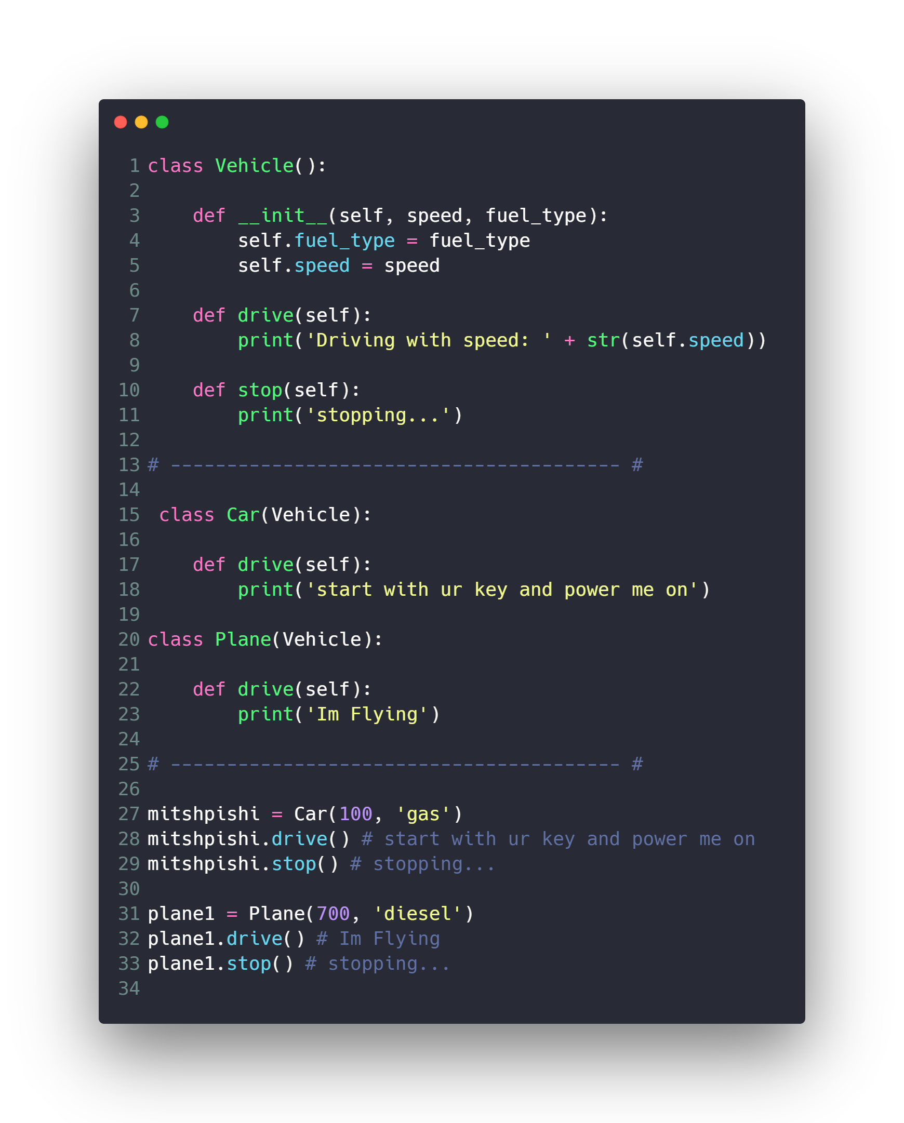
Inheritance

Slide 34
OOP Concepts
Data Hiding (Encapsulation)
Inheritance
Polymorphism
Special Functions and Operators Overloading

Slide 35
Polymorphism

Slide 36
Polymorphism
polymorphism refers to the way in which different object classes can share the same method name but each acts differently.

Slide 37
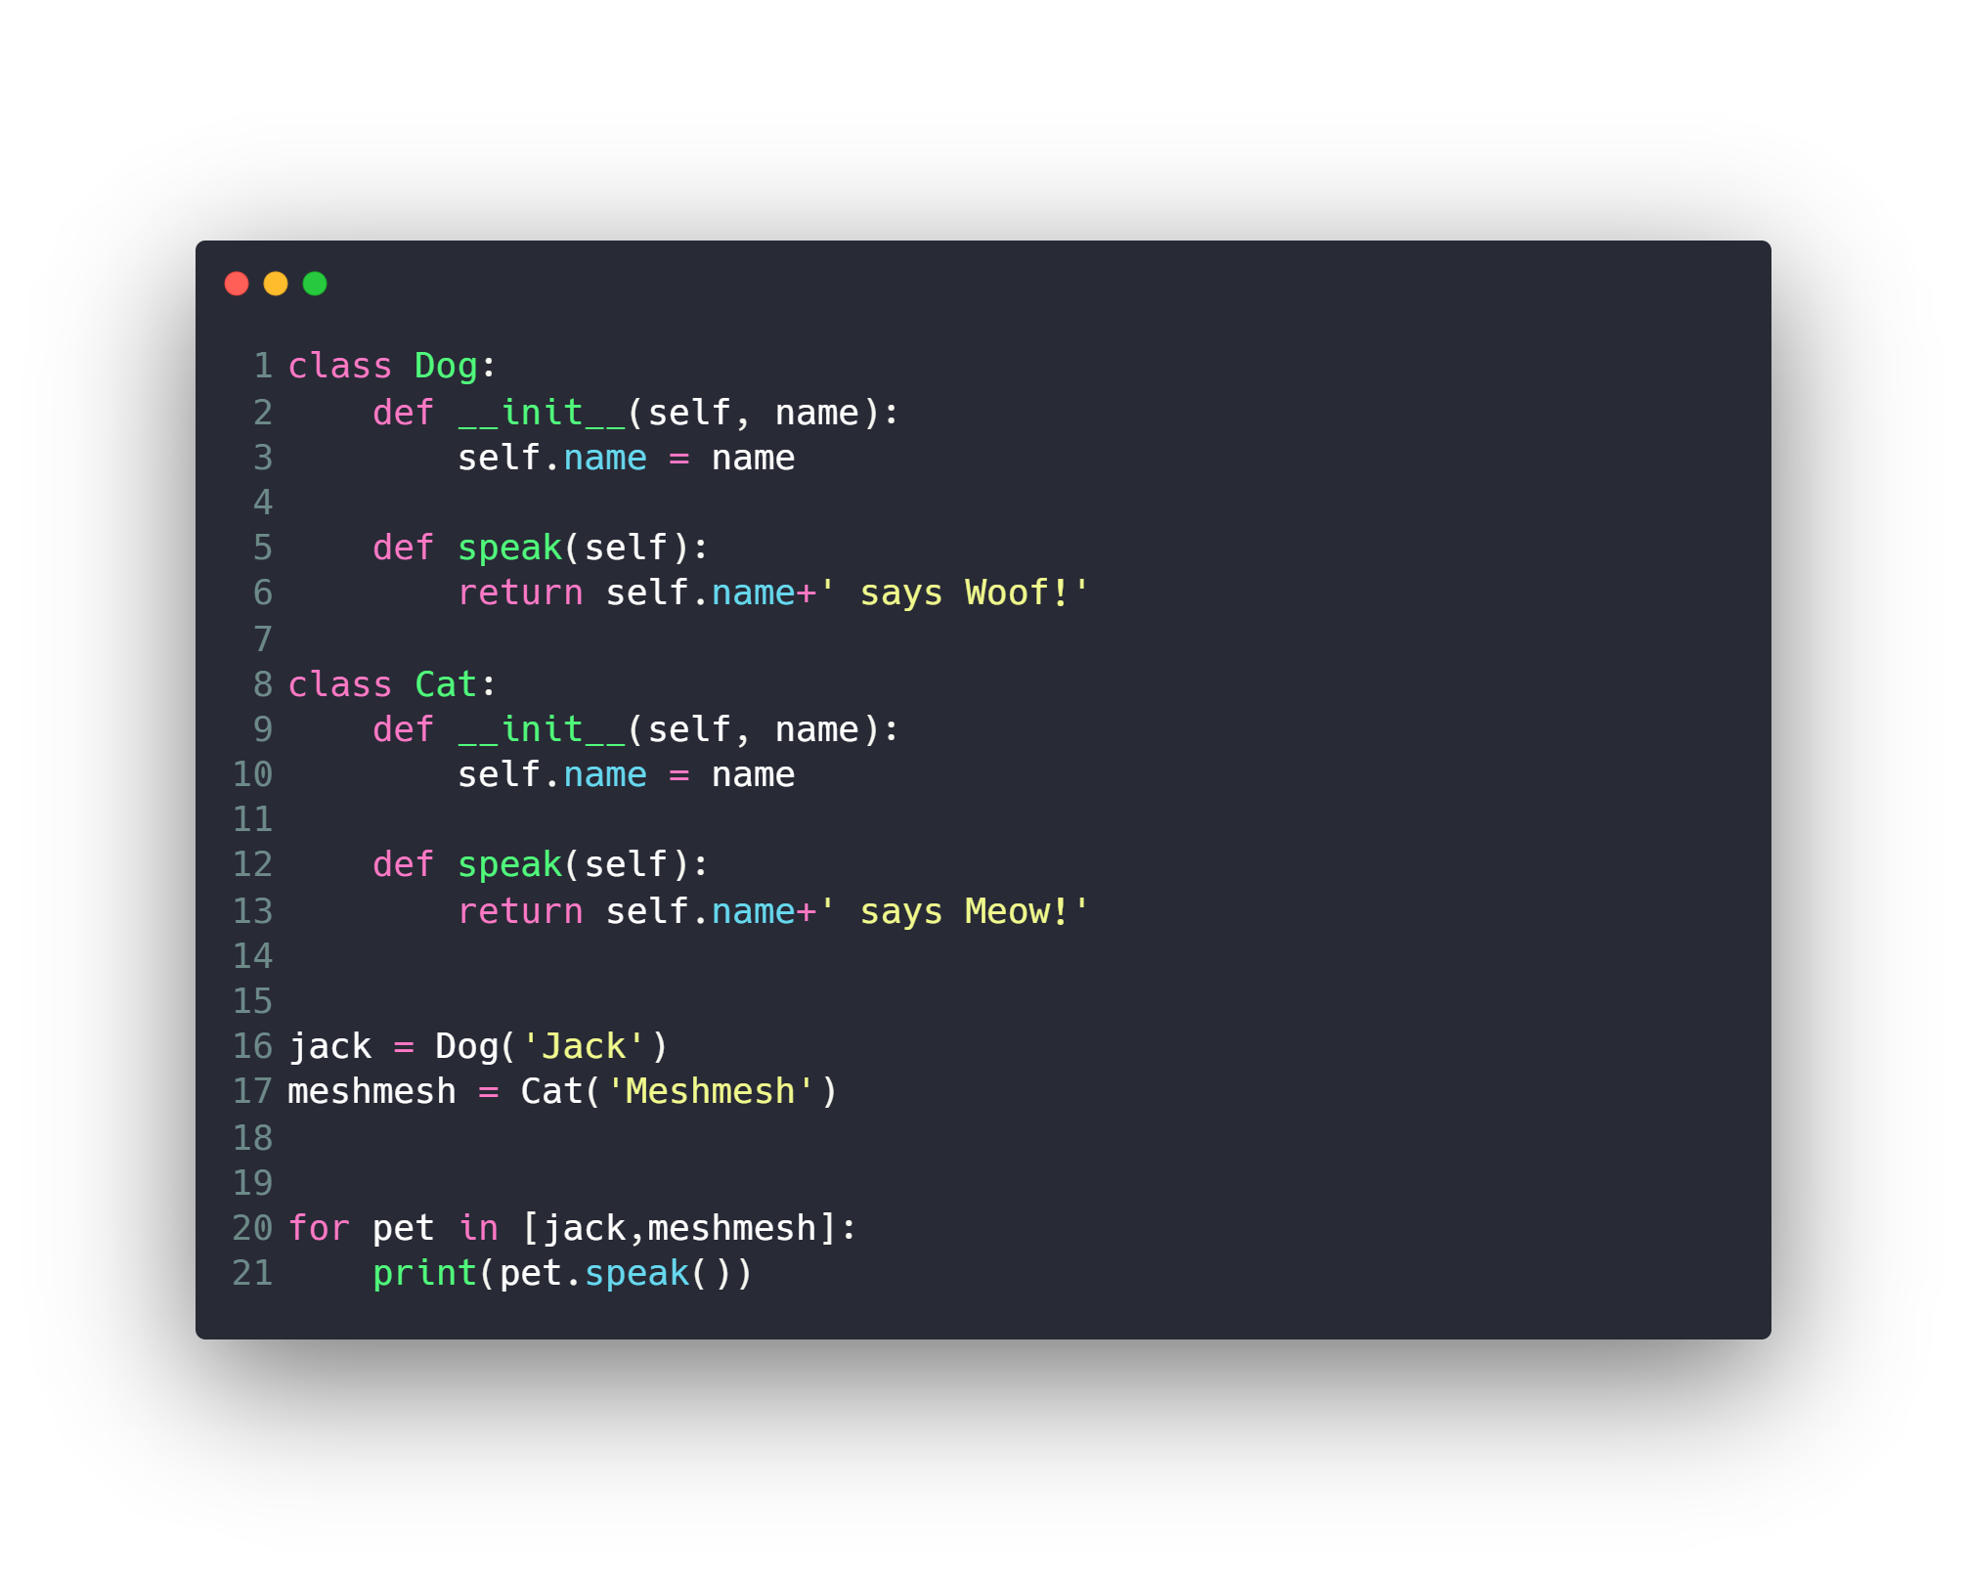
Polymorphism

Slide 38
OOP Concepts
Data Hiding (Encapsulation)
Inheritance
Polymorphism
Special Functions and Operators Overloading

Slide 39
Special Functions and Operators Overloading
Math Operator
Comparison Operator
__add__
__sub__
__mul__
__truediv__
__floordiv__
__mod__
__pow__
__eq__
__nq__
__lt__
__le__
__gt__
__ge__

Slide 40
Special Functions and Operators Overloading
Other Operators
__init__
__str__
…

Slide 41
Other Concepts
Exceptions
Decorators
Iterators and Generators

Slide 42
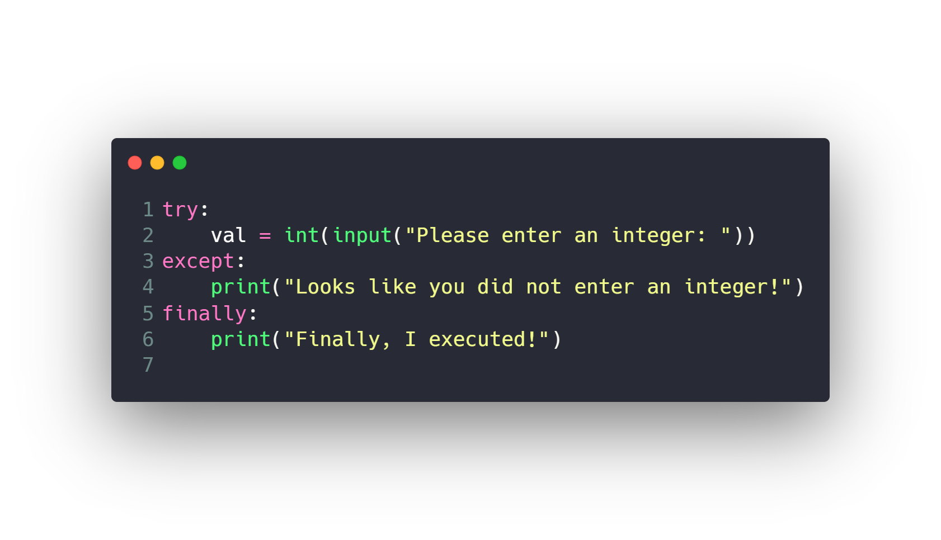
Exceptions
https://www.tutorialsteacher.com/python/error-types-in-python

Slide 43
Other Concepts
Exceptions
Decorators
Iterators and Generators

Slide 44
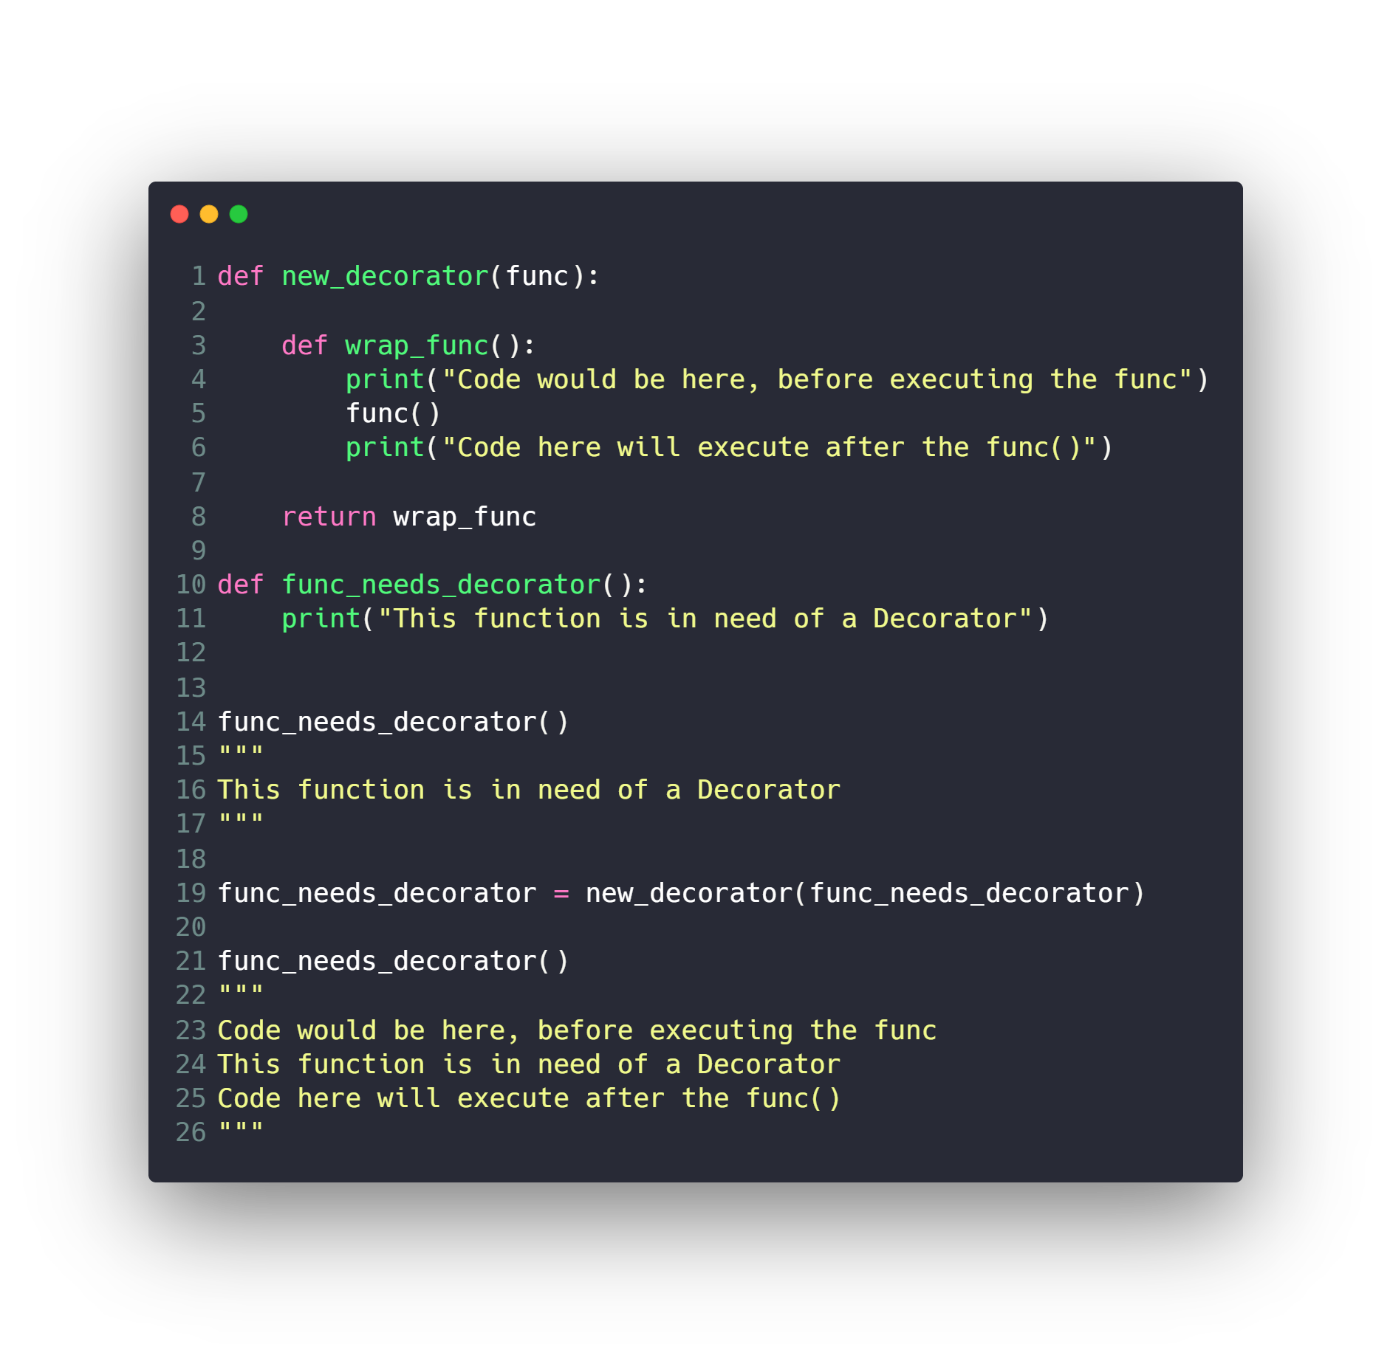
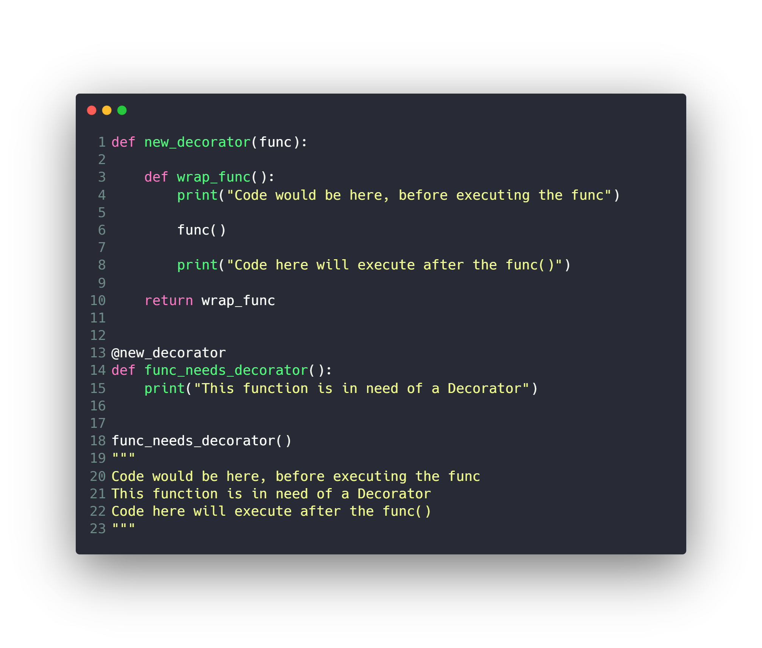
Decorators

Slide 45
Other Concepts
Exceptions
Decorators
Iterators and Generators

Slide 46
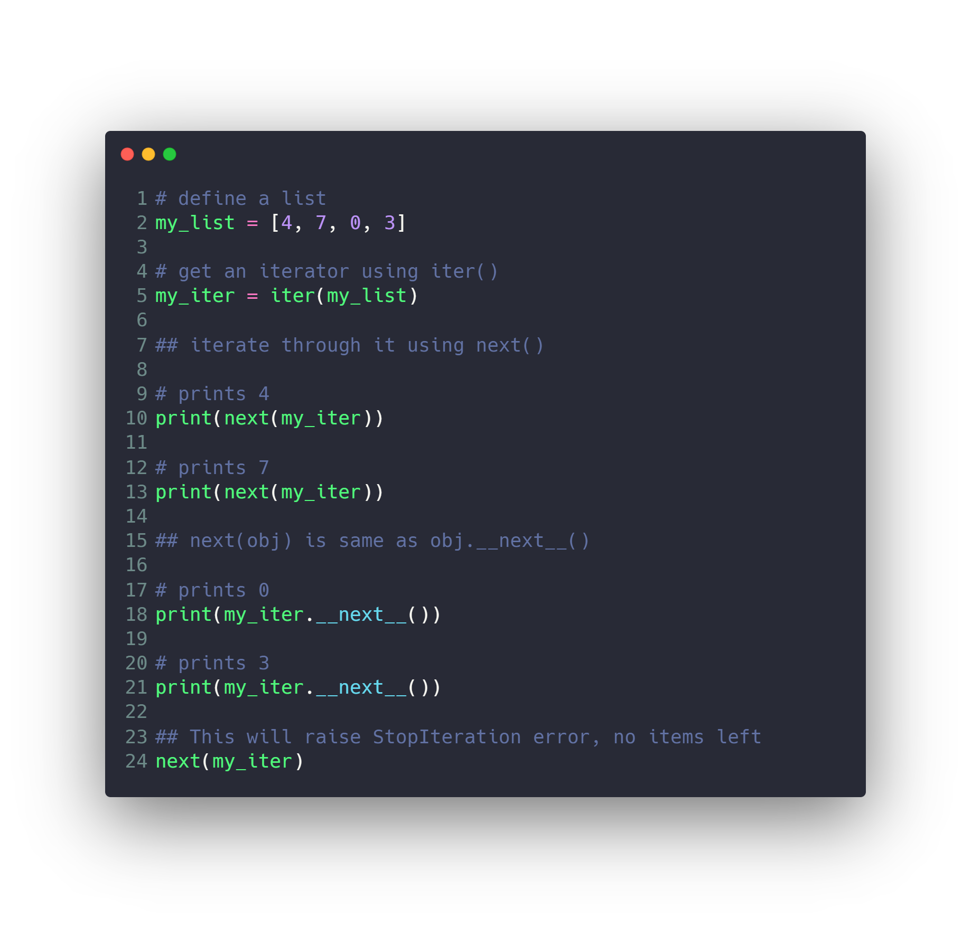
Iterators

Slide 47
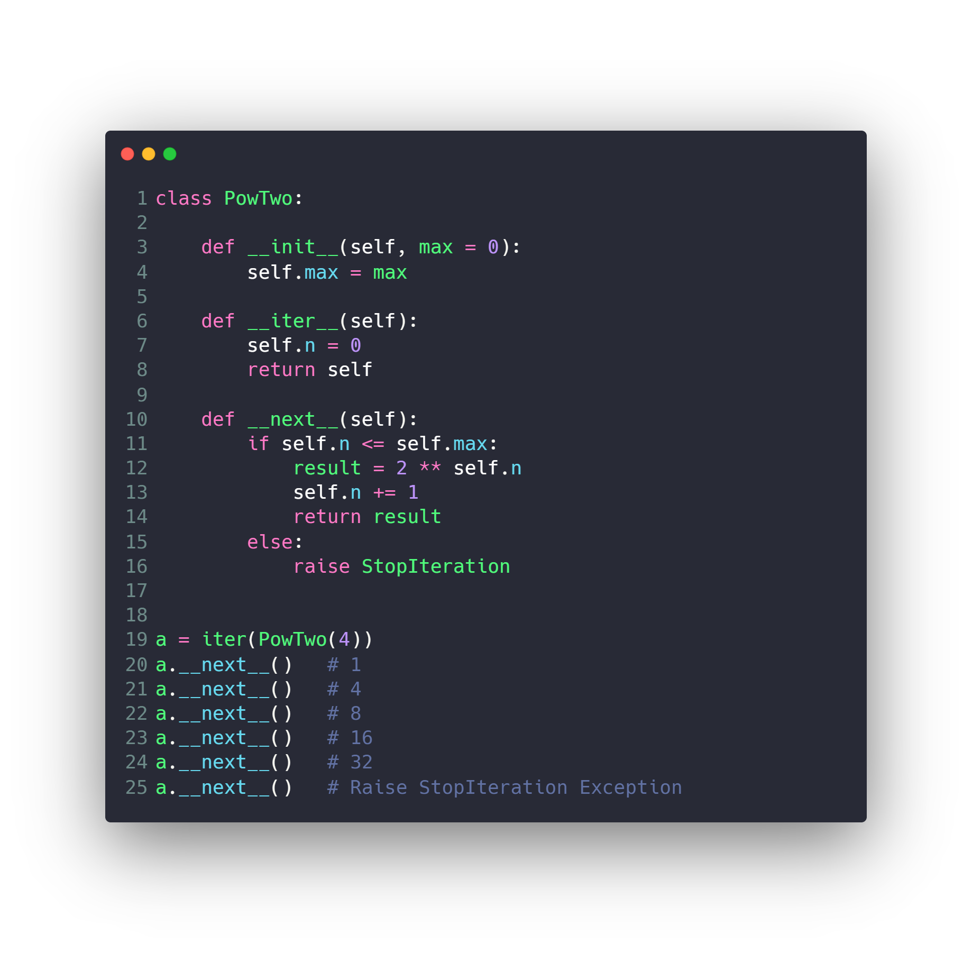
Custom Iterators

Slide 48
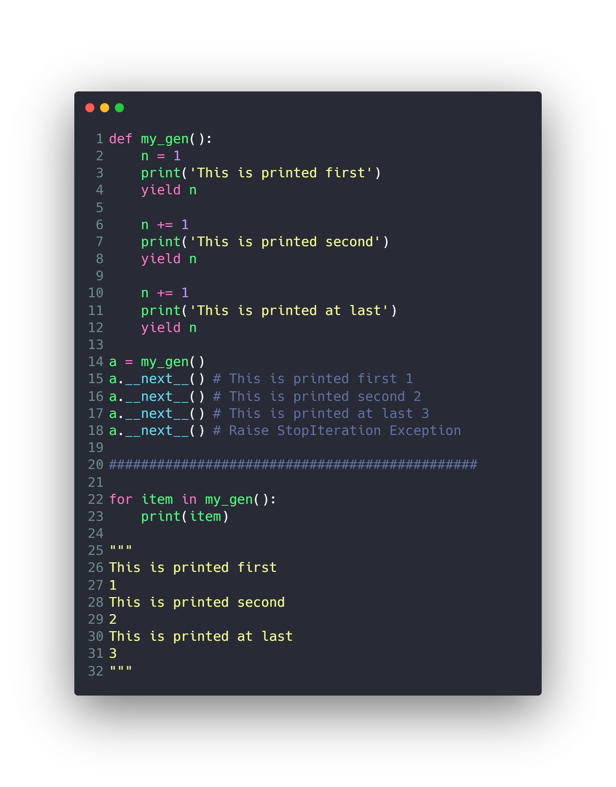
Generator
Much Better
no need to implement __iter()__ and __next__()

Slide 49
Questions ?!

Slide 50
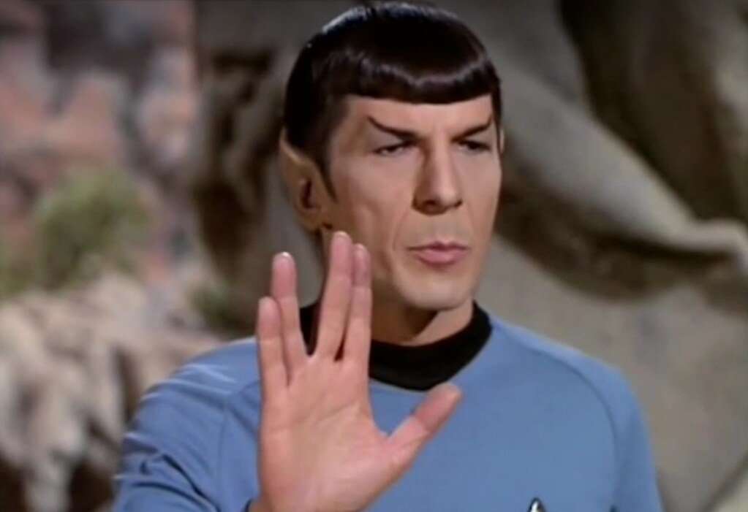
Thanks! >_ Live long and prosper

